Slide 1
Independent Component Analysis - ICA
Prepared By: Dr.Mydhili K Nair, Professor, ISE Dept, MSRIT
For Sem 6 Machine Learning Elective Jan - June 2019

Slide 2
Practical Applications for Independent Component Analysis - ICA

Slide 3
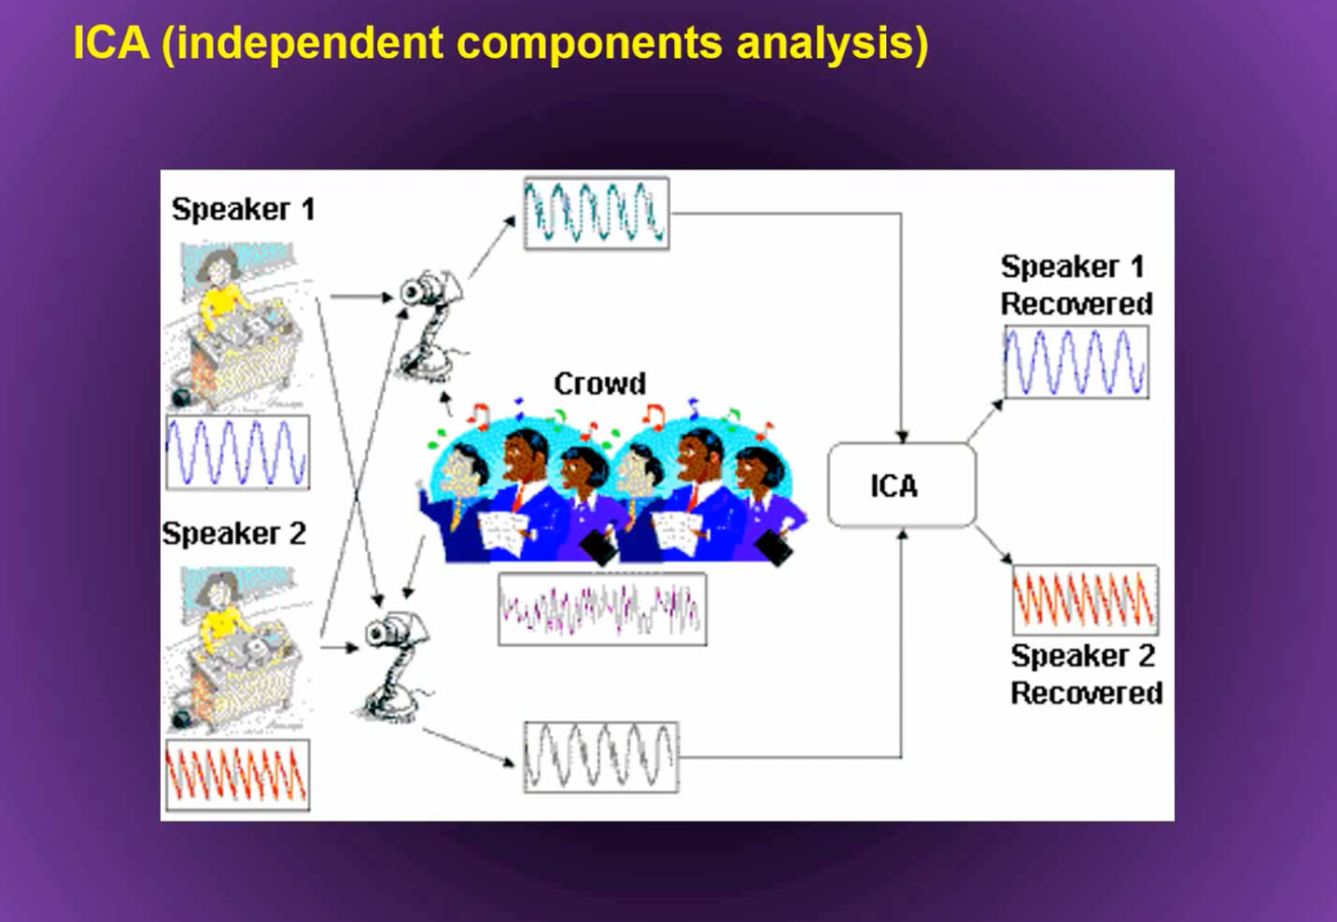
Cocktail Party Problem / Blind Spot Separation

Slide 4
Independent Component Analysis - ICA Explained

Slide 5


What is statistical mutual independence among features?
Rolling a dice - first time getting 6 and rolling it second time and still getting 6
Drawing a card and it being a Queen of Spades with and without card replacement in the deck
Rolling a dice - first time getting 6 and rolling it second time and getting the sum of the two numbers rolled being 9

Slide 6



Random Variables - You know value about one , it does not give you any clue of the value of other
E.g: The sky appears ‘blue’. It gives no information about the other colours.
But, you “observe” the sky as blue.
The sky as orange
And other different hues.
Technique: Given these observables find the “hidden features”

Slide 7
Find a linear transformation of your original feature space into a new feature space such that each of the individual new features are statistically mutually independent of each other.
Such that
Y_{i} ↥ Y_{j}
I(Y_{i ;} Y_{j}) = 0
I(Y ; X ) = ↑
X₁
X₂
.
.
.
.
X_{i}
Y₁
Y₂
.
.
.
.
Y_{i}
⇒

Slide 8
Assumptions
The “hidden features” are independent of one another
They do not follow a Gaussian Distribution
Central Limit Theorem:
Take a bunch of statistically independent variables, that are mutually uncorrelated , sum them up together (create a linear transformation)and this sum tends towards a normal distribution according to the law of large numbers.

Slide 9
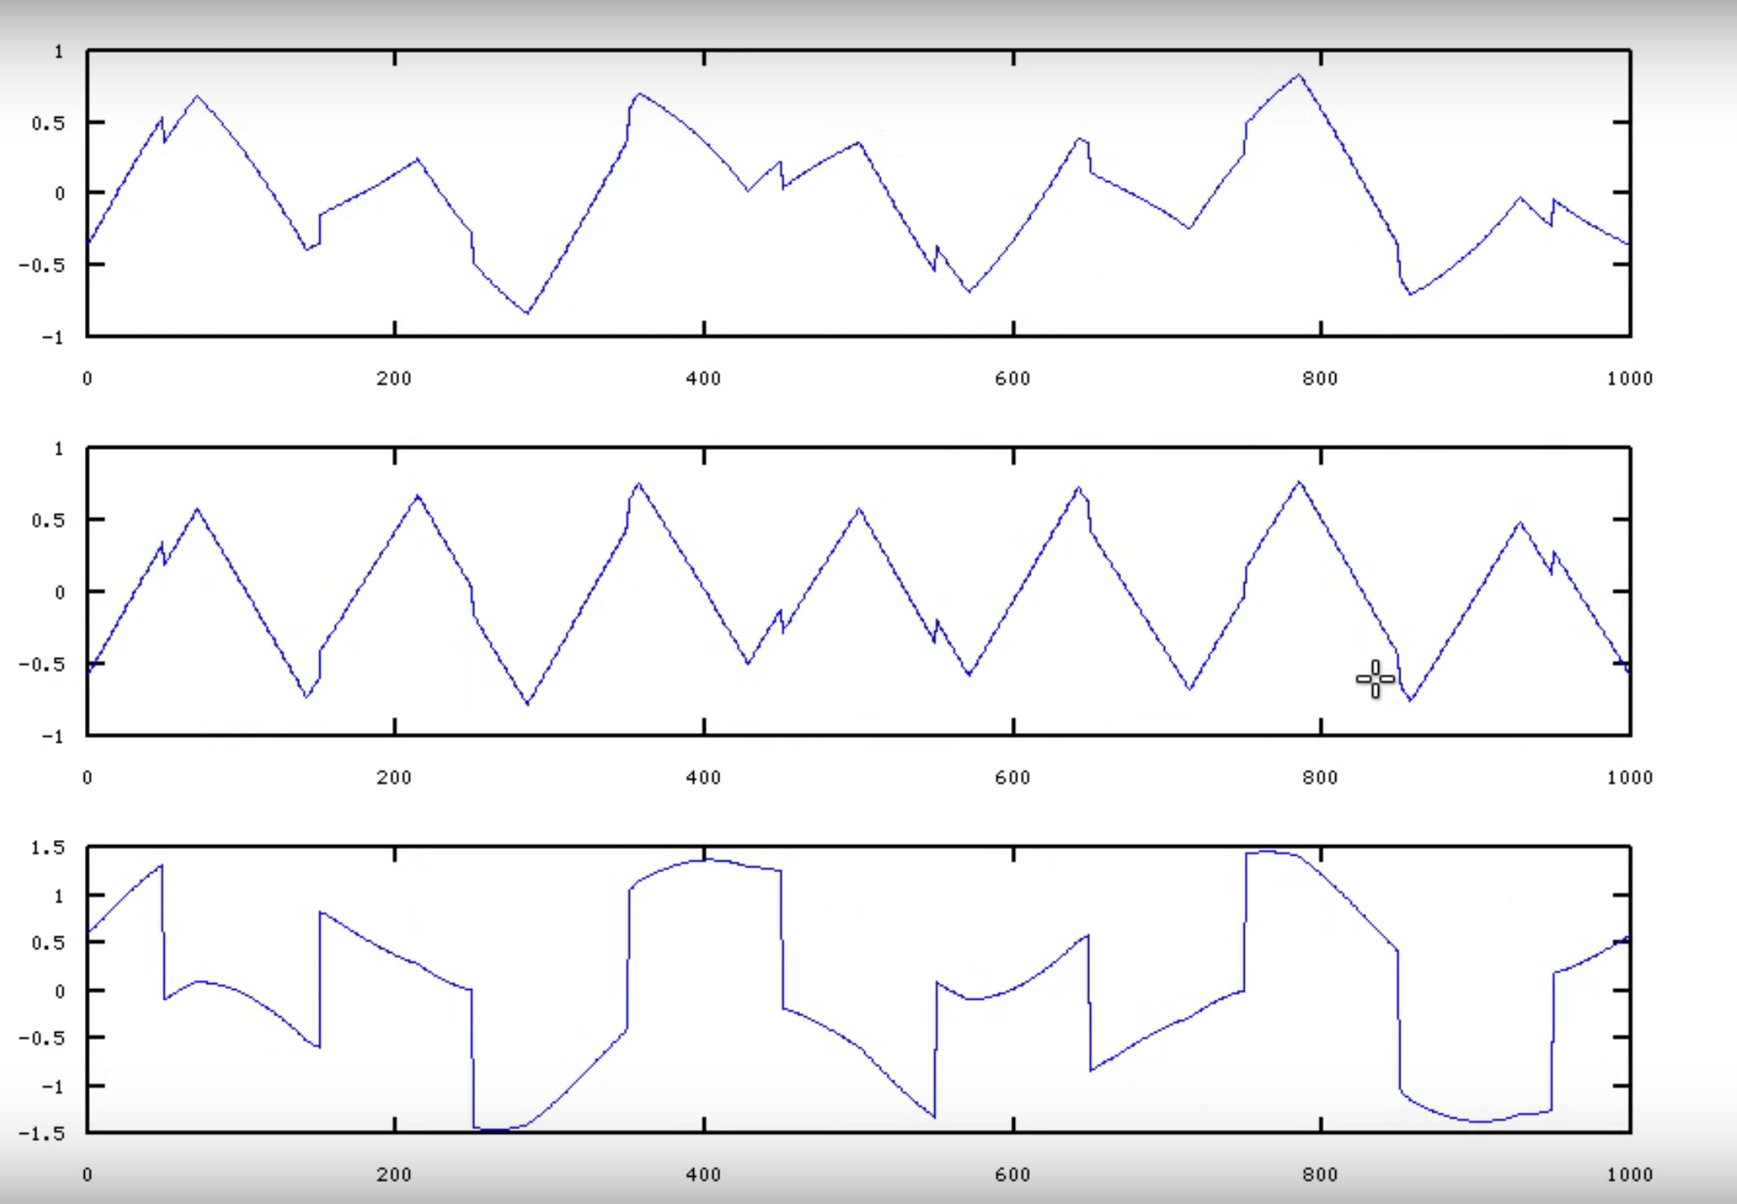

Slide 10

⇦ Feature
⇦ Feature
Projects on to a feature space so that these features are mutually independent of one another
⇦ Sample
⇦ Sample

Slide 11
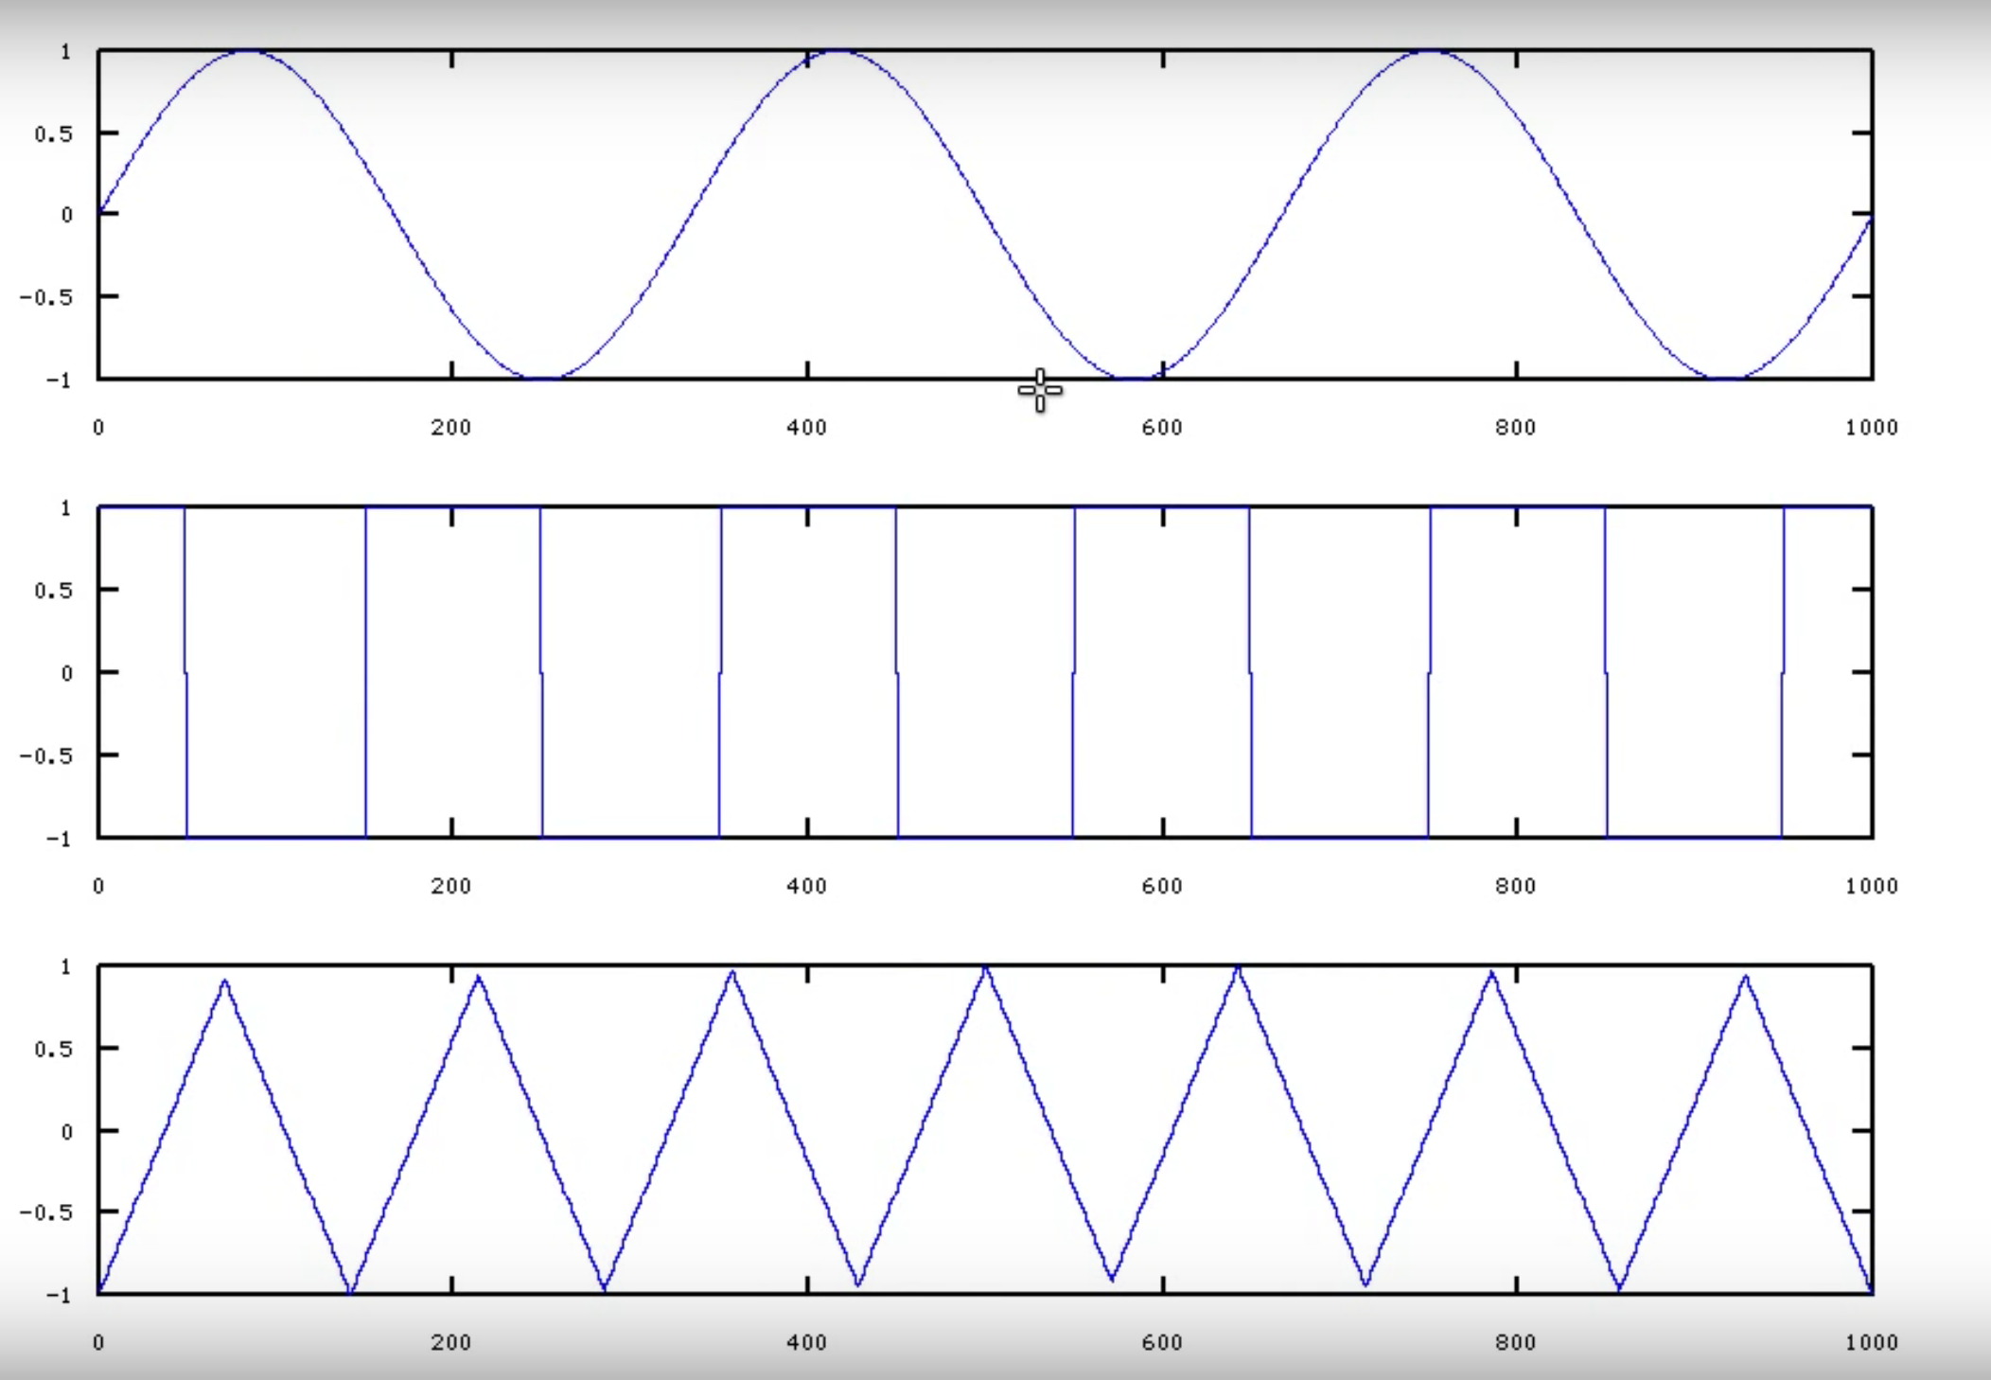

Slide 12
ICA & PCA
Both PCA and ICA are un-supervised
PCA “expects” Gaussian distribution while Gaussian Distribution “kills” ICA
After Linear Transformation, PCA Projections are “orthogonal” to each other while ICA Projections are not, since the transformed feature space is statistically mutually independent of each other and therefore not orthogonal.
PCA works on the principle of finding “maximum variance” while ICA works in finding features that are statistically mutually independent of each other.
PCA results in “ordered features” while ICA does not care about the importance or rank of the features.

